Slide 1
Software
for YTM
MAT4372-Project Presentation
Presented by Cara Li 300049083

Slide 2
Bond
Definition: A bond is a fixed-income instrument used by governments or companies to raise money by borrowing from investors.
Characteristics:
Regularly scheduled payments
Return of invested principal
More predictable and stable

Slide 3
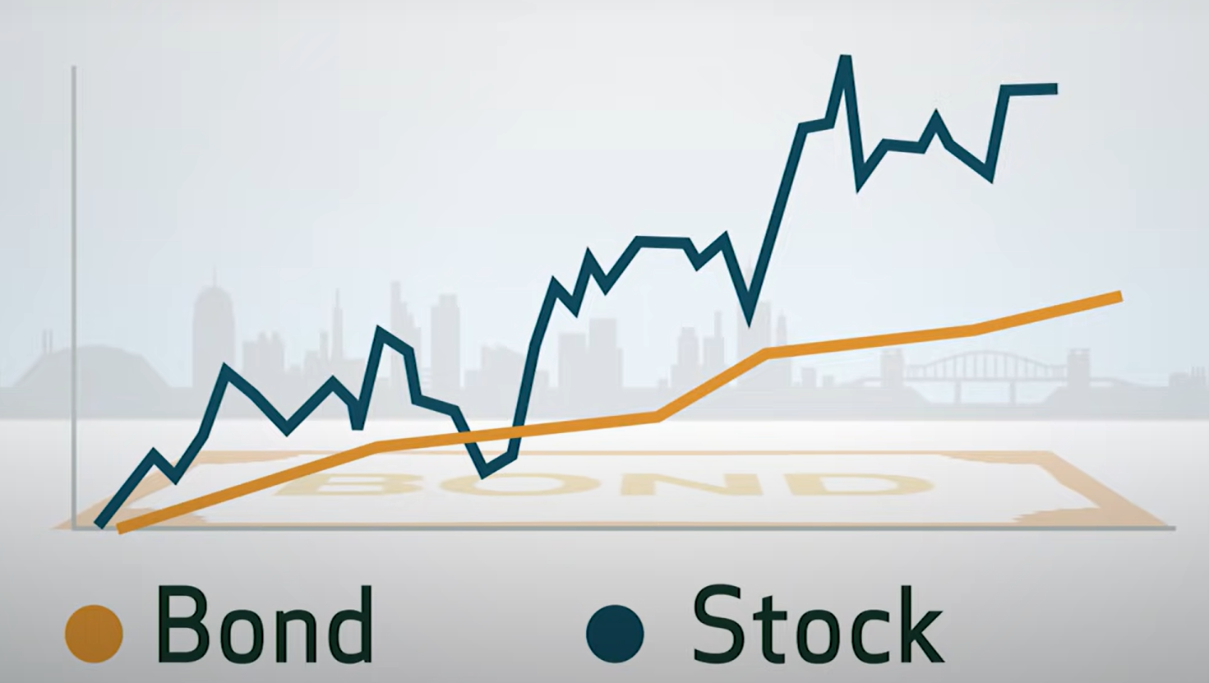
Bond (contd.)
Bond vs. Stock
Stock profits and losses are driven by market forces
Less predictable
Default Risk: the possibility that the issuer defaults on paying back the principal
Government — low coupon rate, low default risk
Corporation — high coupon rate, high default risk

Slide 4
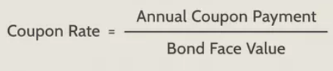
Coupon Rate
Definition: Coupon rate is the rate of interest paid by bond issuers on the bond’s face value.
Coupon payments are represented as a percentage of the face value of a bond
Face Value represents the price at which a bond was issued.

Slide 5
YTM (Yield to maturity)
Definition: The YTM is the total return anticipated on a bond if the bond is held until it matures.
Usage:
Useful for estimating whether buying a bond is a good investment.
Used to compare bonds that have different maturities and coupons

Slide 6
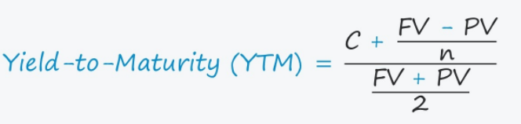
YTM (contd.)
FV = Face Value
PV = Present Value (Bond Price)
C = Coupon
n = Number of Compounding Periods (Years of Maturity)

Slide 7
YTM Calculator
Using Android Studio

Slide 8
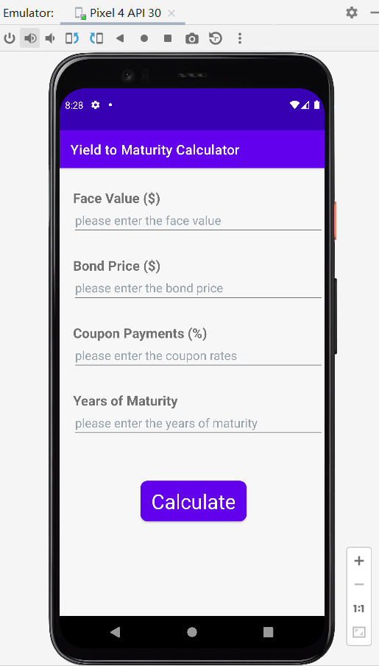
YTM CALCULATOR
Main Function:
Calculate the YTM (yield to maturity) based on :
current bond price ($)
face value of the bond ($)
coupon rate (%)
number of years to maturity

Slide 9
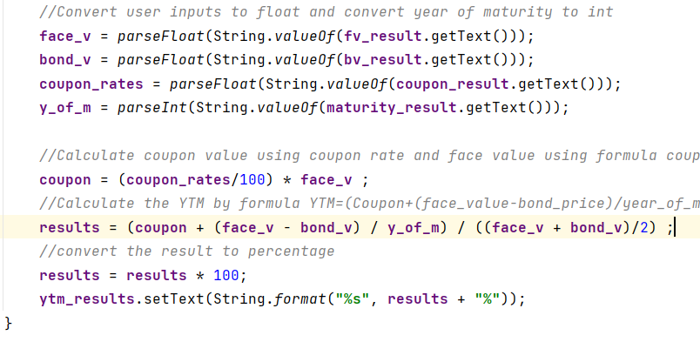
Code related
Get the data from user inputs and show them in the result page
Convert them to proper data types
Calculate the coupon value
Calculate the YTM value
Convert and show the final result in percentage

Slide 10
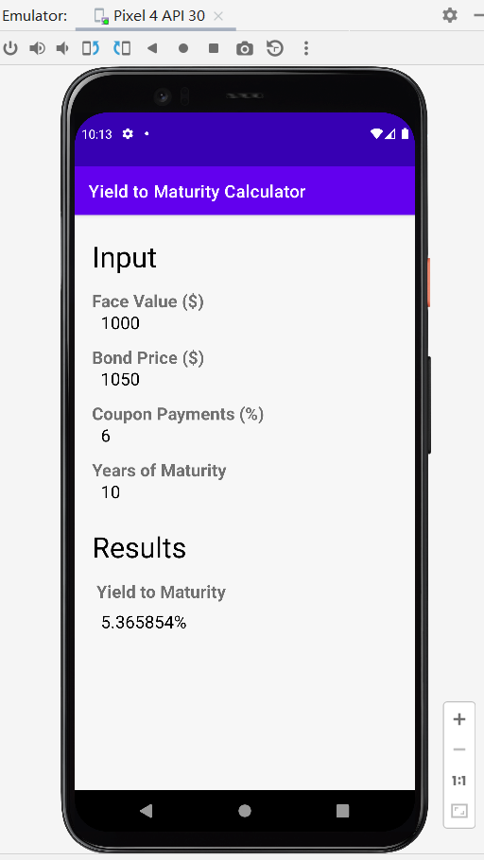
Example
There is a bond that will mature in 10 years. This bond has a face value of $1000 and coupon rate 6%. The current bond price is $1050.
Now calculate the YTM.

Slide 11
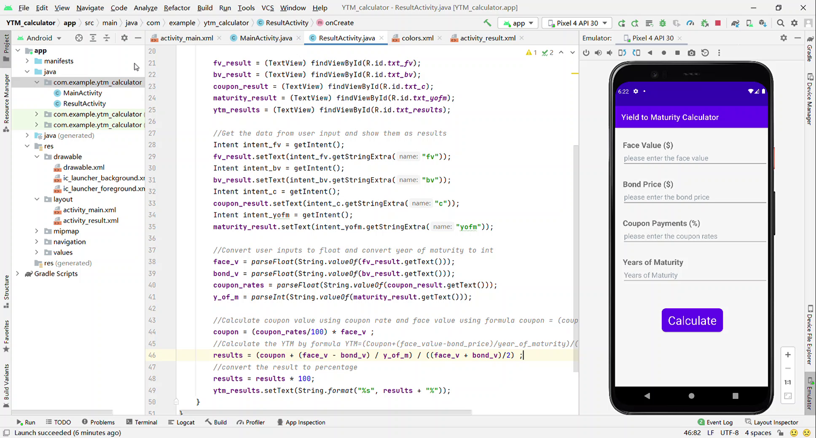
Example (contd.)

Slide 12
Reference
Jason Fernando (2020). What is Bond? Investopia. https://www.investopedia.com/terms/b/bond.asp
Claire Boyte-White (2021). How Can I Calculate a Bond's Coupon Rate in Excel? Investopia.
https://www.investopedia.com/ask/answers/051815/how-can-i-calculate-bonds-coupon-rate-excel.asp
2022. Definition of 'Coupon Rate'. The Economics Times.
https://economictimes.indiatimes.com/definition/coupon-rate
What is yield to maturity? WallStreetPrep.
https://www.wallstreetprep.com/knowledge/yield-to-maturity-ytm/
TD Ameritrade (2017). Investing Basics: Bonds
https://www.youtube.com/watch?v=IuyejHOGCro&ab_channel=TDAmeritrade

Slide 13
Thank you

